Slide 1

Mood Predictor
Frank Ouyang
http://aiclub.world

Slide 2
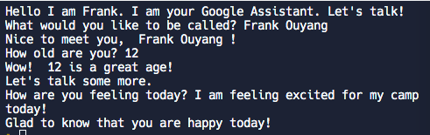
Application
My app is an intelligent chatbot that can detect your emotions through user input.

Slide 3
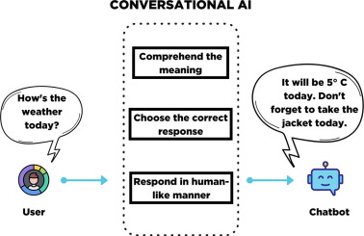
Architecture
The AI chatbot allows the user to train the model and add custom actions.

Slide 4
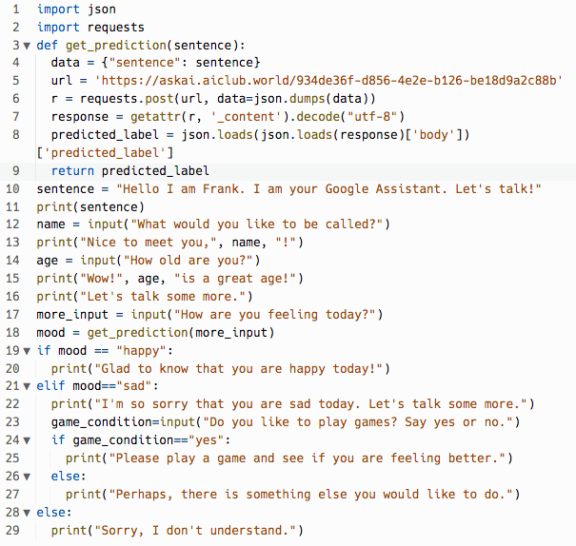
Describe Your App?
There are 29 lines of code.
The IDE I used was Replit.com.

Slide 5
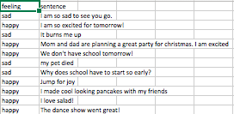
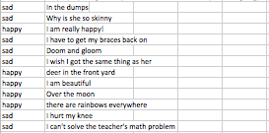
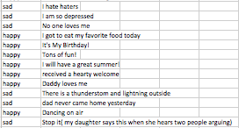
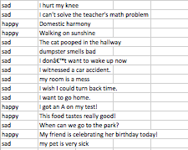
How did you train your AI?
I got my data from AI Club World.
The metrics were “feeling” and “sentence.”

Slide 6
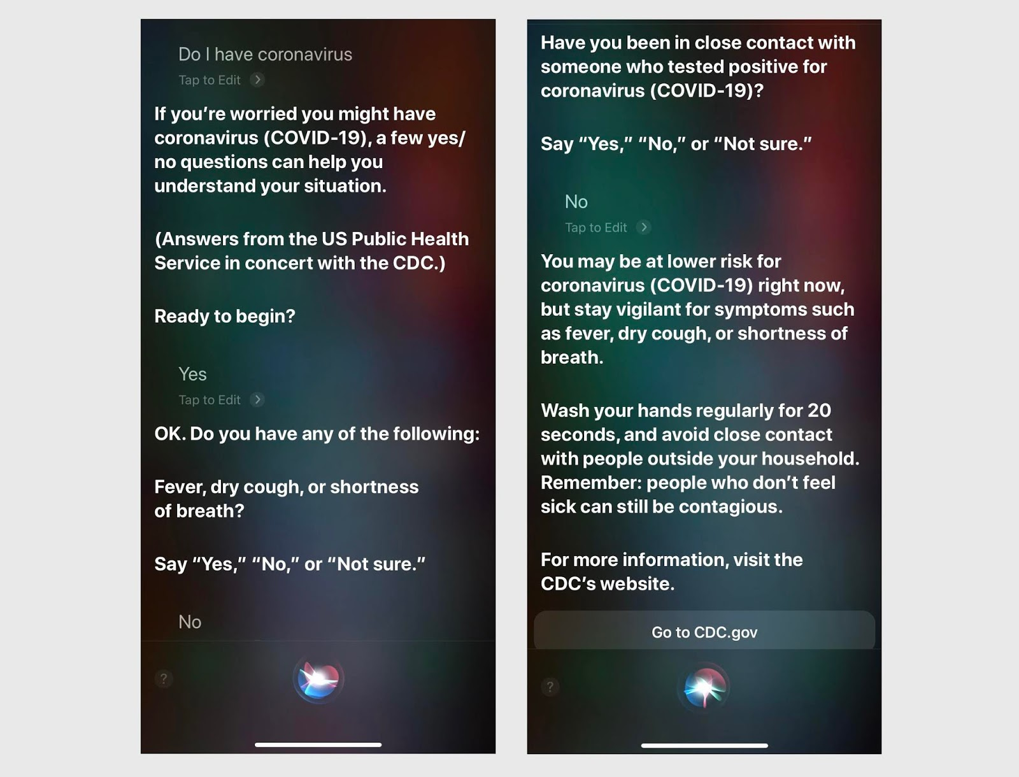
What would you like to do next?
I would like to make my chatbot more visually pleasing. E.g Siri or Google

Slide 7
Demo
https://replit.com/@FrankOuyang1/AIMoodPredictorProject#main.py

